Slide 1

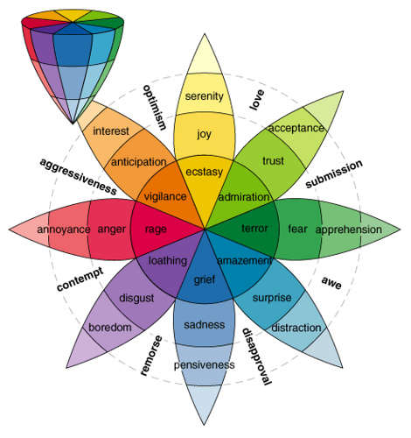
Multi-Modal Sentiment & Emotion Classification Using Computer Vision and NLP
Brendon Vineyard
Advisor: Dr. Grabowski
SUNY Potsdam – Spring 2025
Notes:
Good morning everyone. My name is Brendon Vineyard, and today I'm presenting my senior project: Multi-Modal Sentiment and Emotion Classification Using Computer Vision and NLP. This project focuses on combining image and text analysis into a unified model to better classify human emotions and sentiments, especially in contexts like social media.

Slide 2

Problem Motivation
Social media mixes text/images
Models analyze separately, miss content
Goal: fuse text and image analysis
Notes:
The motivation behind this project starts with the way people communicate online. Platforms like Instagram or Twitter often combine images and text together, but traditional machine learning models usually analyze them separately. This separation misses a lot of emotional context. My goal was to create a model that fuses image and text inputs, so we can classify emotions and sentiments together, getting a fuller, richer understanding.

Slide 3
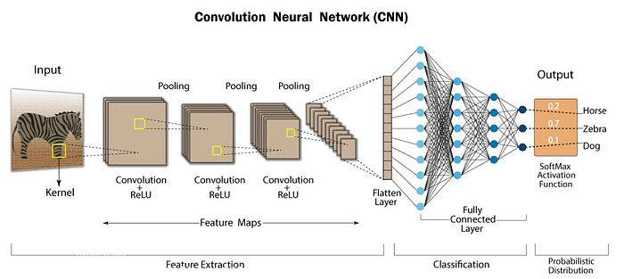
Model Architecture Overview
CNNs trained on 3 separate image datasets for emotion.
Notes:
Starting with images, I used what’s called a Convolutional Neural Network, or CNN. CNNs are a special type of artificial neural network that’s designed to recognize patterns in visual data — things like faces, objects, or emotions from images. In this project, I trained three separate CNNs. Each one learned emotional features from different facial emotion datasets, giving the model a broad analysis of how emotions appear visually.

Slide 4
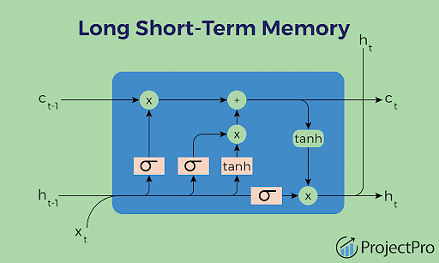
Model Architecture Overview
Text is processed using LSTM for sentiment prediction.
Notes:
For the text input, I used a BiLSTM model — which stands for Bidirectional Long Short-Term Memory network. This is a type of neural network that's very good at identifying sequences of words, not just individually, but considering their order and context from both directions — forward and backward. This helped the model better detect the sentiment hidden inside captions or short text posts.

Slide 5
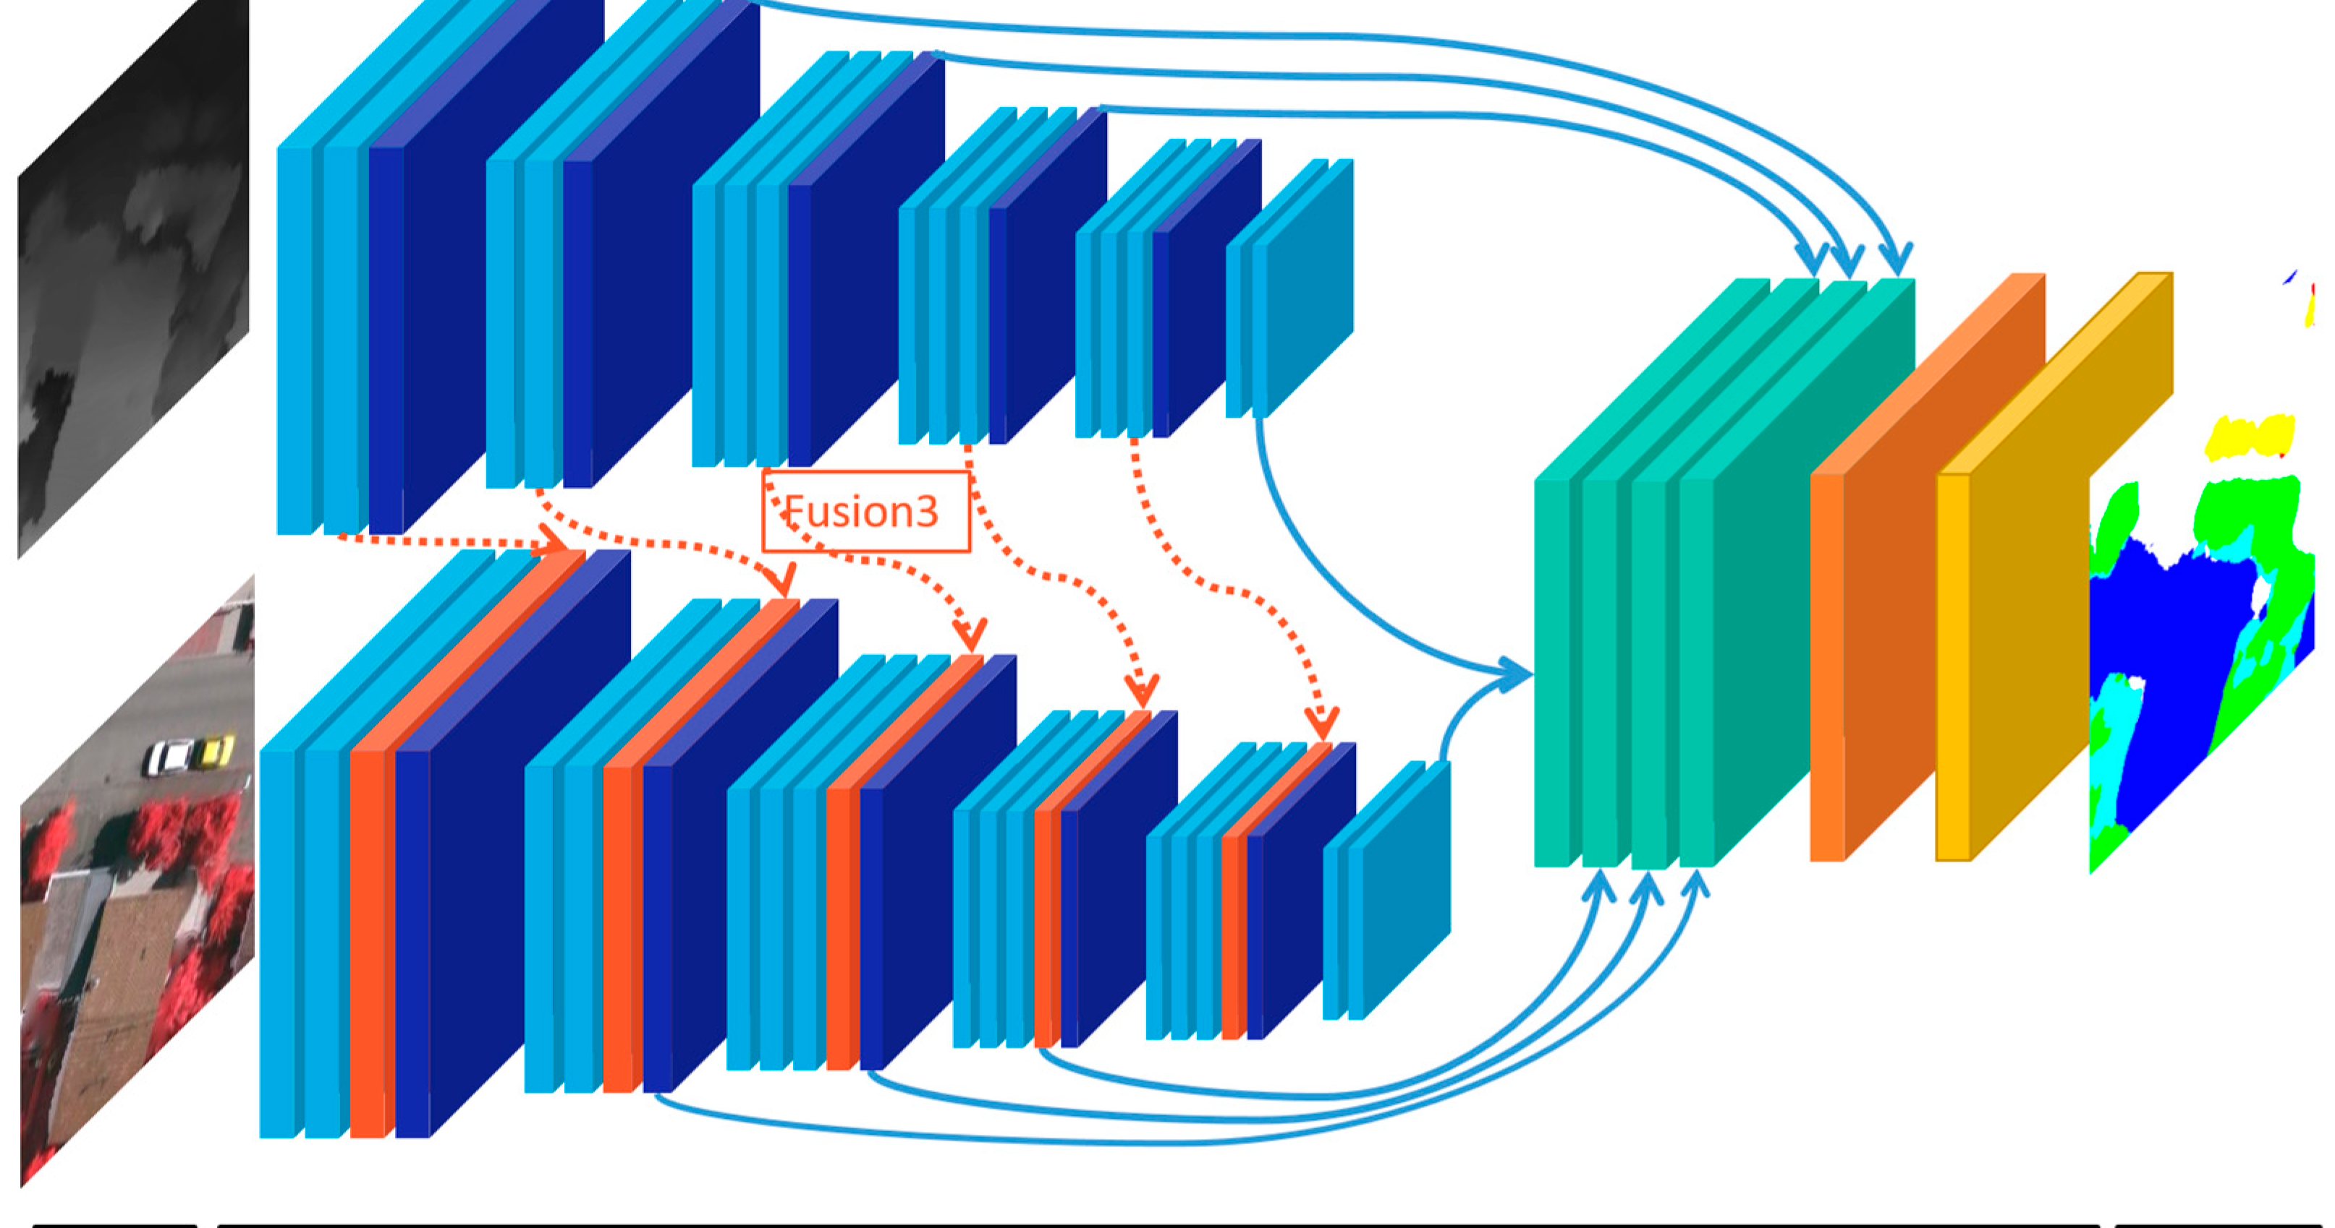
Notes:
With separate models trained on images and text, the next step was bringing them together. But first, let’s talk about the data that powered these models.

Slide 6
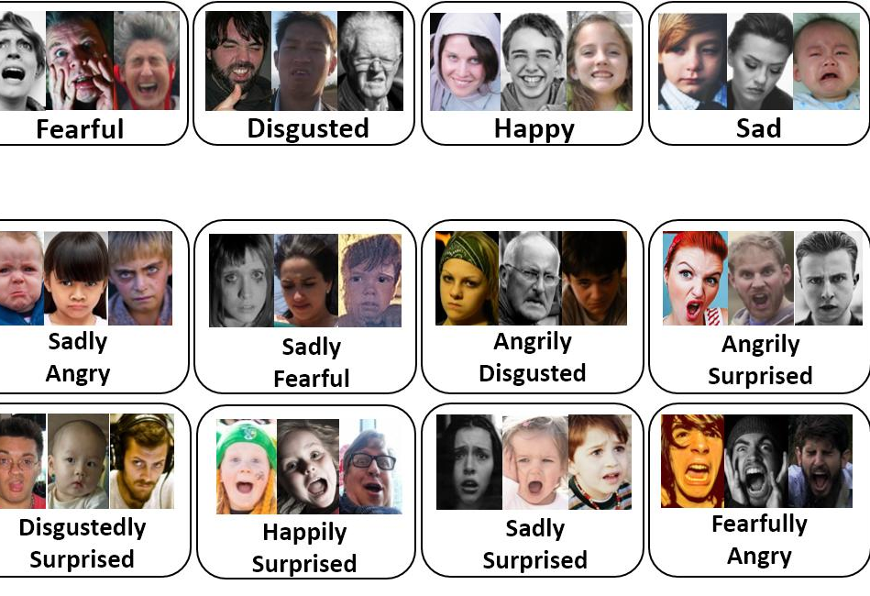

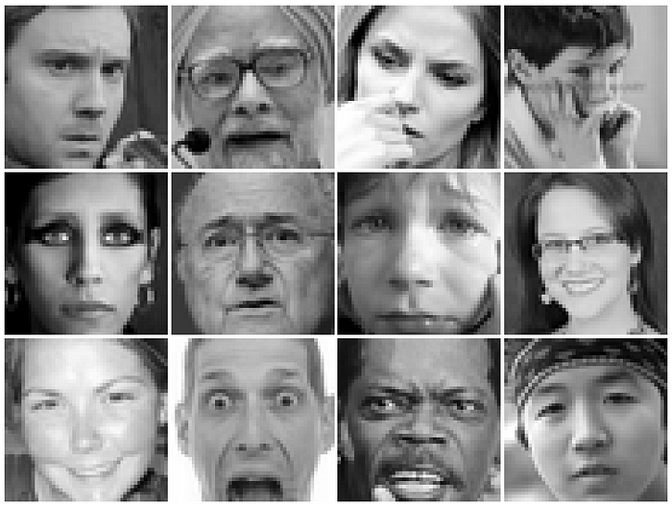
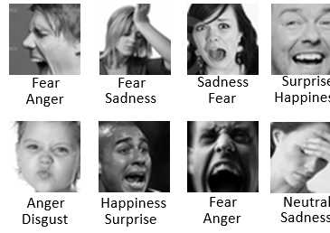
Datasets Used
FER-2013: Grayscale emotion-labeled faces.
RAF-DB: Refined facial emotion dataset.
FER+: Enhanced labeling for FER.
Seniment140: 1.6 million tweets labeled with sentiment.
Notes:
For images, I used three well-known facial emotion datasets:
FER-2013 — grayscale images of faces labeled with emotions like anger, sadness, happiness. (32000)
RAF-DB — a refined dataset with higher-quality emotion labels. (15000)
FER+ — another improved labeling version of FER. (35000)
For text, I used Sentiment140, a dataset of 1.6 million tweets labeled as positive, neutral, or negative.
These datasets ensured the model had enough variety to learn from real-world examples.

Slide 7
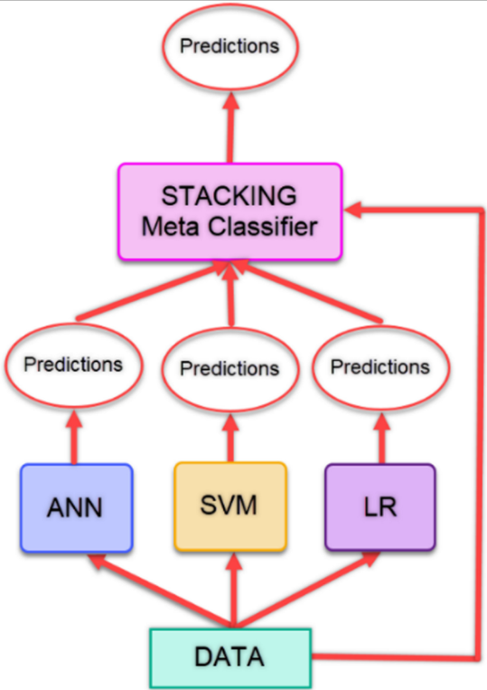
Fusion Strategy
Images processed by 3 CNNs
Softmax outputs stacked, classified
Notes:
Once the CNNs finished analyzing the facial images, each of them produced what’s called a softmax output — basically a list of probabilities for different emotions. I took the outputs from all three CNNs and stacked them together. Then, another classifier learned how to interpret these combined outputs and make the final emotion prediction. This step is called fusion because it combines different sources of information into one decision.

Slide 8
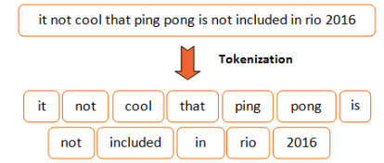
Sentiment
Text tokenized, passed to BiLSTM
Notes:
At the same time, the text data — after being processed by the BiLSTM model — produced its own prediction about sentiment. So now, I had emotion predictions from images and sentiment predictions from text — both feeding into the full system for final decision making.

Slide 9
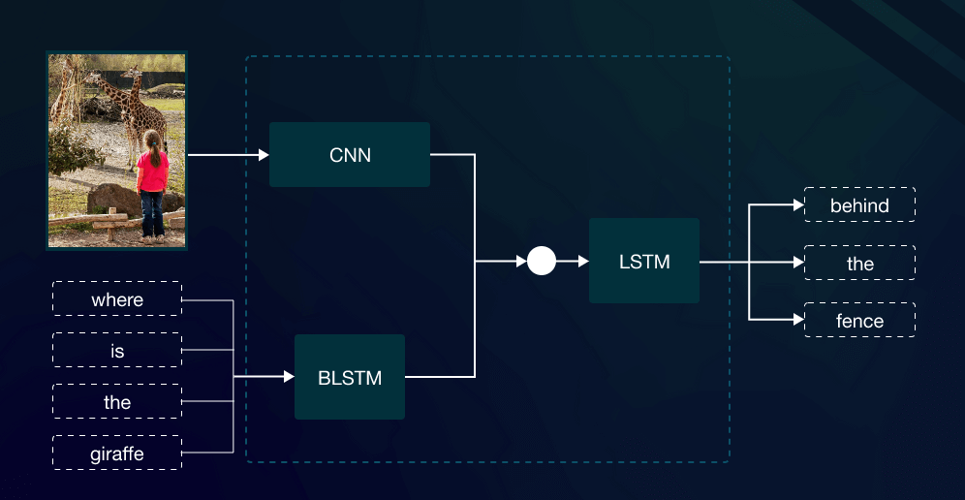
Notes:
On the image side, facial inputs are passed through three separate CNNs, each trained on a different emotion dataset. These CNNs produce feature representations of the emotions seen in the faces. On the text side, captions or tweets are tokenized and passed through a BiLSTM, which extracts the sentiment meaning from the text. At the fusion stage, these two separate outputs — one from vision and one from language — are concatenated together into a single joint representation. This combined vector is then passed through Dense layers and finally a Softmax layer, allowing the model to predict both emotion and sentiment simultaneously. By fusing both modalities inside a unified architecture, this proves that the model is not just analyzing images and text separately — it’s a fully integrated multi-modal system.
After building the initial fusion system, I focused on improving the model’s performance through a series of refinements and design changes.

Slide 10

Model Improvements
Replaced meta-classifier with MLP
Added Dropout and BatchNorm
Filtered inconsistent emotion classes
Aligned to 5-class emotion labels
Used pretraining and freezing options
Notes:
Here are some of the major improvements:
I replaced the original simple classifier with a Multilayer Perceptron, or MLP — essentially a deeper, smarter decision-maker.
I added dropout layers, which randomly turn off parts of the model during training to help prevent overfitting.
I used batch normalization to stabilize learning and speed up training.
I also carefully filtered and realigned emotion labels across all datasets to make sure everything matched a five-class emotion system: Happy, Sad, Angry, Fear, and Neutral.

Slide 11
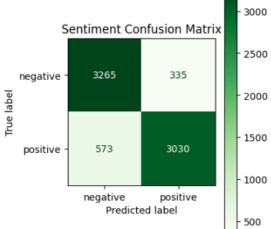
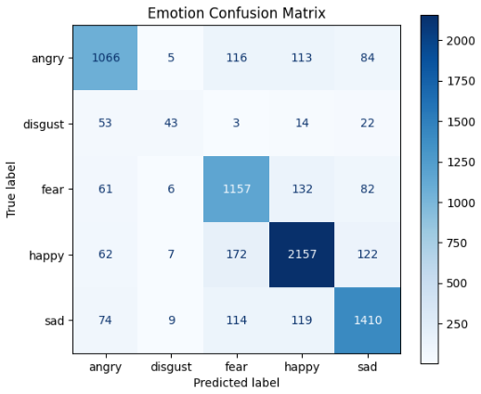
Final Performance
Emotion Accuracy: up to 95.00%
Sentiment Accuracy: 82%-95% range
Achieved with joint model combining FER, RAF, FER+, and Sentiment140.
Notes:
The final model performed strongly:
For emotion recognition from images, accuracy reached up to 95%.
For sentiment recognition from text, accuracy ranged between 82% and 95% depending on conditions.
This validated that fusing visual and language features really does lead to stronger emotional understanding.

Slide 12



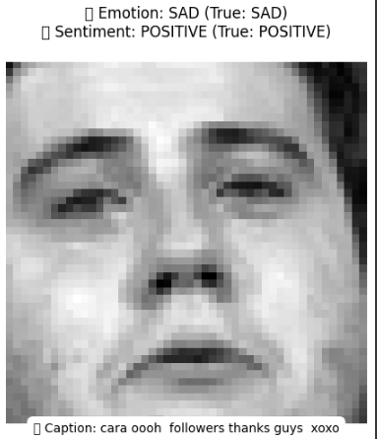
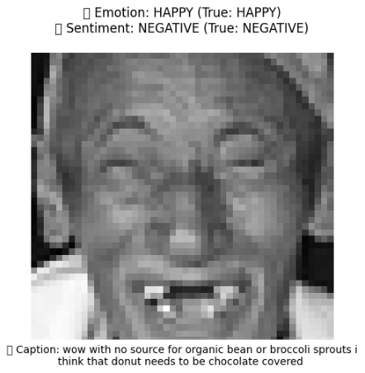
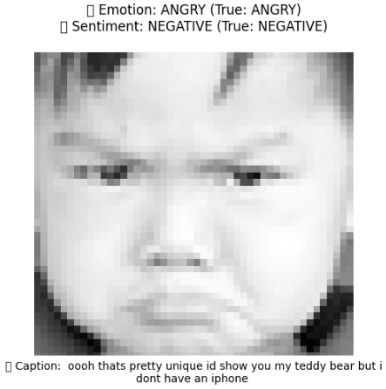
Notes:
After achieving strong performance, I created a way for users to interact with the model — not just through code, but visually through a web application.

Slide 13

Testing and Gradio App
Multi-Modal Model Emotion & Sentiment Generator
Notes:
I created an interactive Gradio demo that automatically samples and displays multiple image-caption pairs from the dataset. For each example, it shows the predicted and true emotion and sentiment, along with confidence bar charts. Users can select how many examples to view in a clean, scrollable gallery. This demo highlights how the model fuses visual and text inputs and demonstrates real-world applications like content moderation, sentiment tracking, and mental health analysis.

Slide 14

Challenges Faced
Emotion label mismatches across datasets
Balancing sentiment and emotion learning
Batch size vs GPU limits
Overfitting on smaller datasets
Notes:
Of course, there were many challenges:
Emotion labels across different datasets didn’t match exactly, so I had to carefully relabel and realign the data.
It was difficult to balance learning between emotion and sentiment — they behave very differently.
Hardware limitations, like GPU memory, forced me to adjust batch sizes and model settings.
And overfitting was a constant risk, especially with smaller datasets like RAF-DB.

Slide 15

Key Takeaways
Fusion improves emotion understanding
Pretraining and ensembles boost accuracy
Small tweaks improve performance
Applications: sentiment, health, marketing
Notes:
This project taught me several important lessons:
First, multi-modal AI — combining different types of data — creates much richer models, but it also introduces new complexities.
Second, even simple architectural choices like adding dropout or batch normalization can make a huge difference.
And third, careful planning around datasets, preprocessing, and training strategy is just as important as the model itself.
Overall, it was a deep dive into real-world AI building, not just theory.

Slide 16


Capstone Project CIS 480 – Spring 2025
Author: Brendon Vineyard
Email: vineyabn207@potsdam.edu
Notes:
Thank you all so much for listening. I’d be happy to answer any questions you have about the project, the techniques, or the results.

